Slide 1

Exploratory data analysis

Slide 2
Crypto, a form of digital token or “coins” that exist on a distributed and decentralized ledger called a blockchain, is a popular investment nowadays.
A crypto is a collection of binary data which is designed to work as a medium of exchange. Individual coin ownership records are stored in a ledger, which is a computerized database using strong cryptography to secure transaction records, to control the creation of additional coins, and to verify the transfer of coin ownership.
Over $40 billion worth of cryptocurrencies are traded every day. They are among the most popular assets for speculation and investment, yet have proven wildly volatile. Fast-fluctuating prices have made millionaires of a lucky few, and delivered crushing losses to others. Could some of these price movements have been predicted in advance?

Slide 3
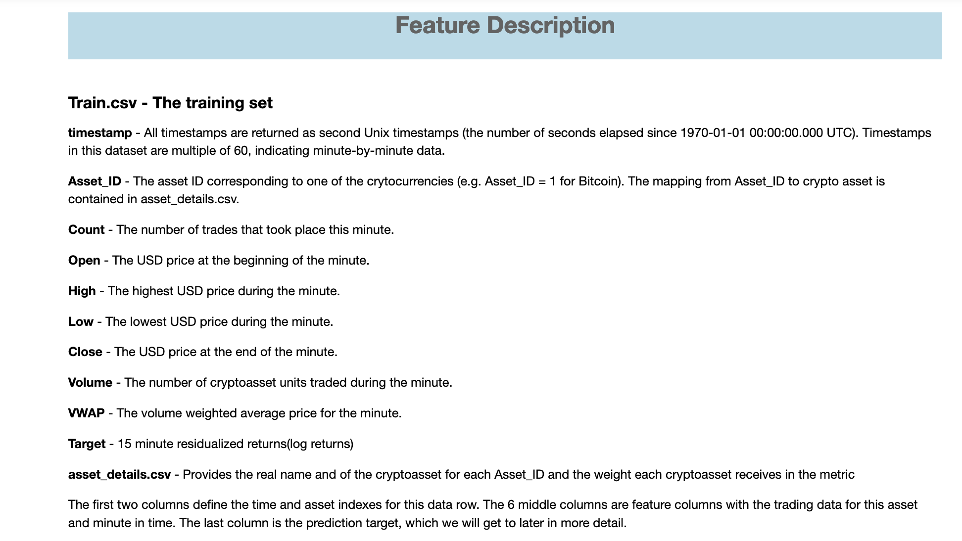

Slide 4
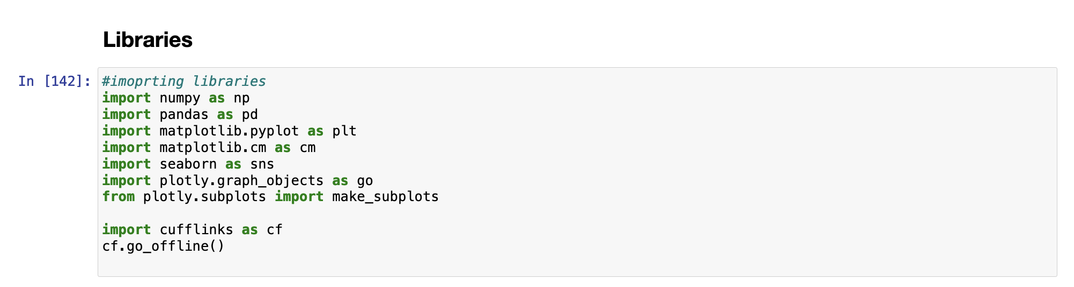

Slide 5
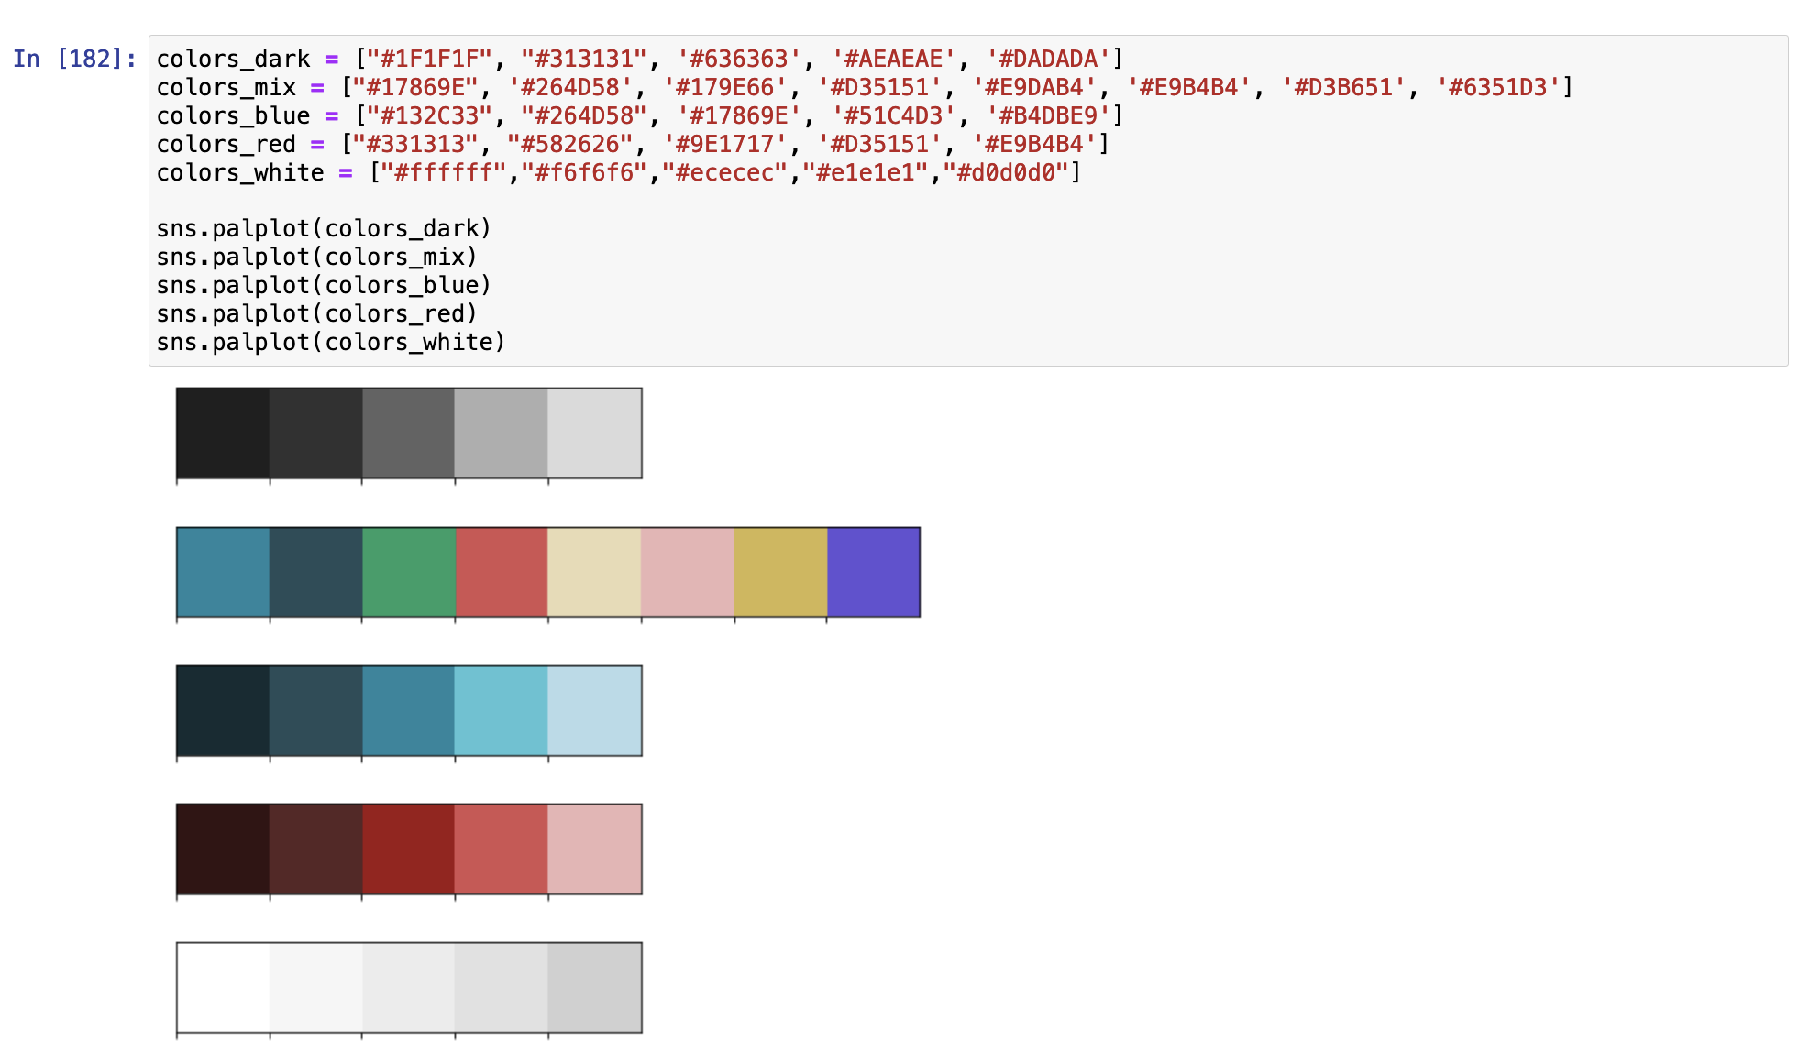

Slide 6
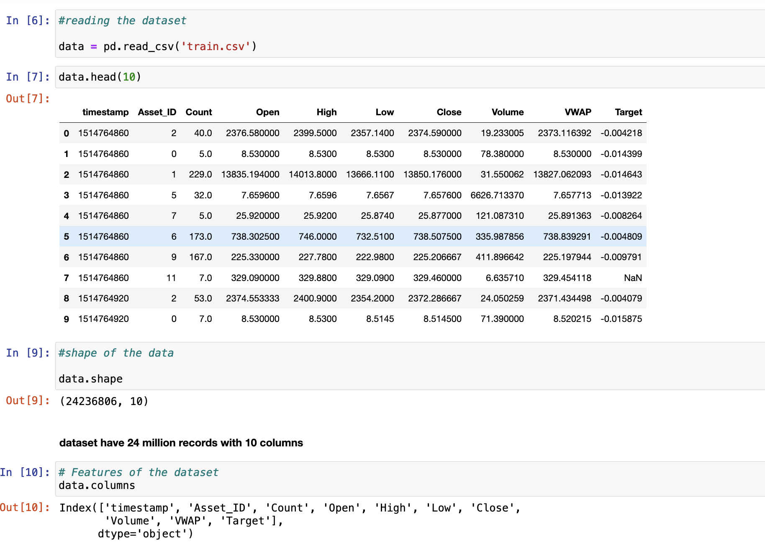

Slide 7
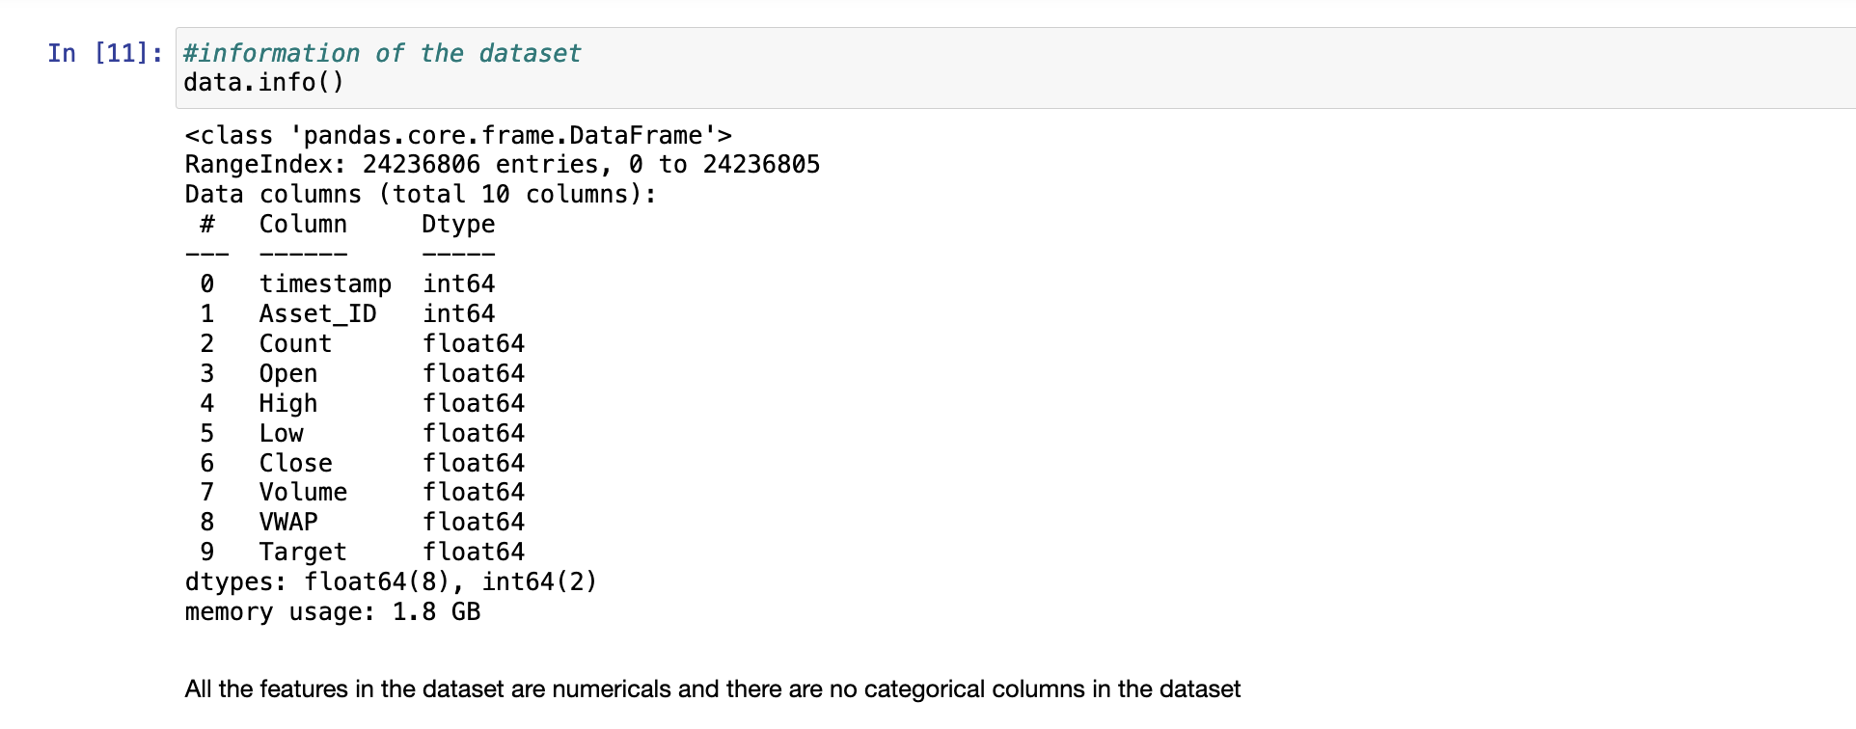

Slide 8
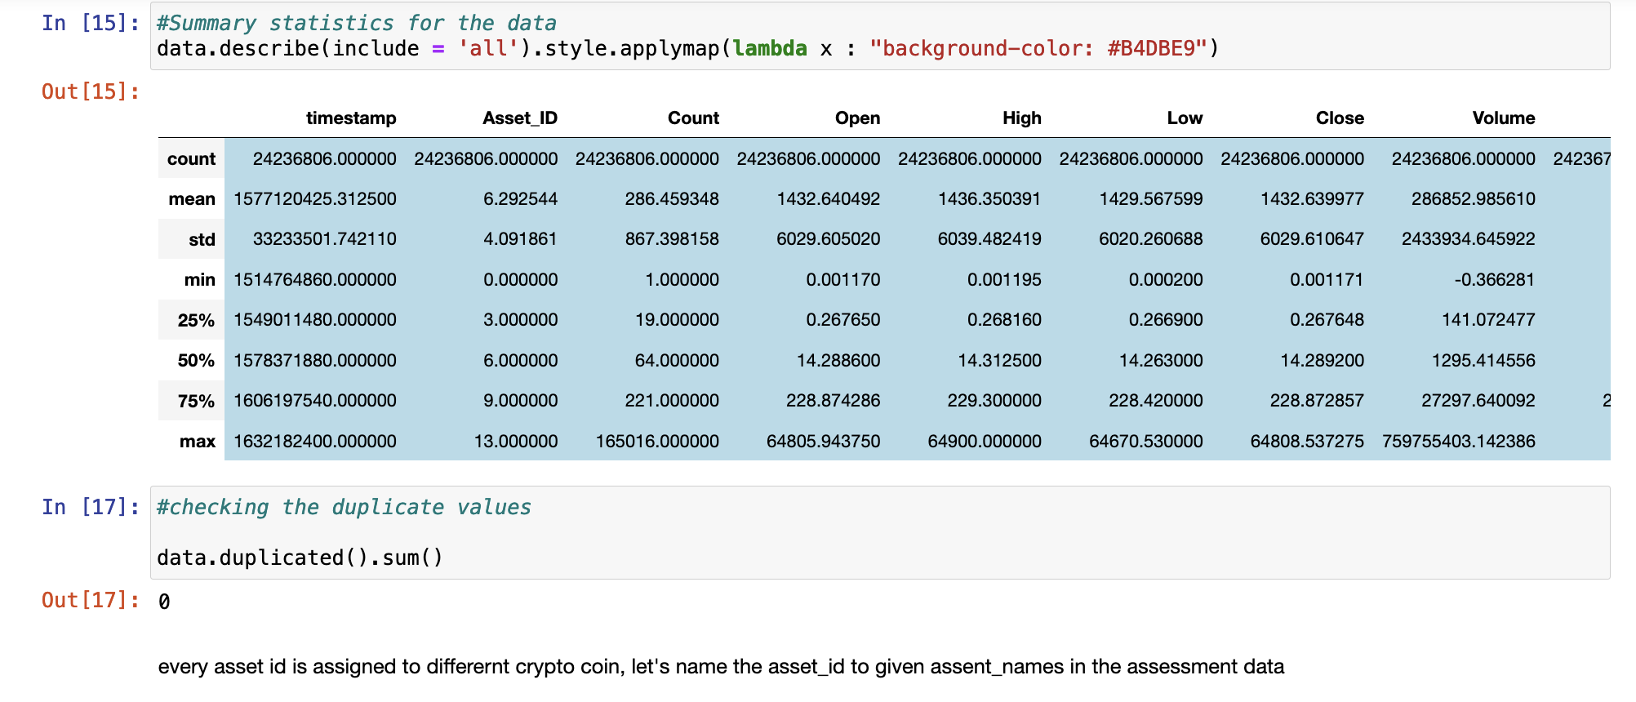

Slide 9
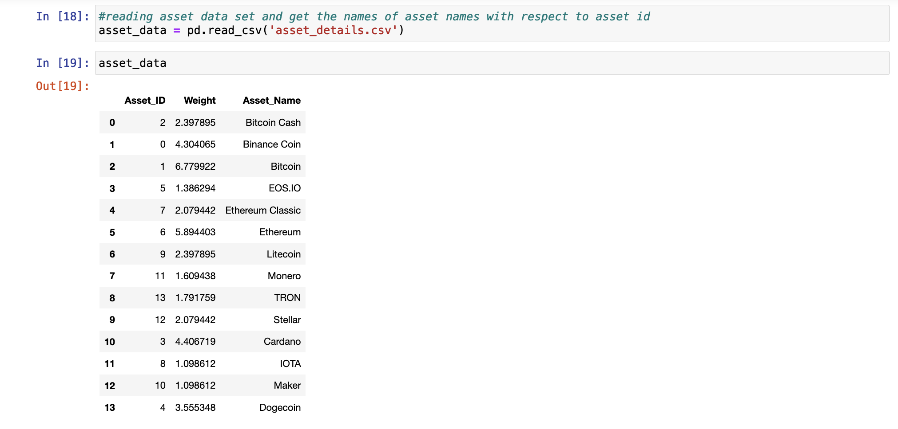

Slide 10
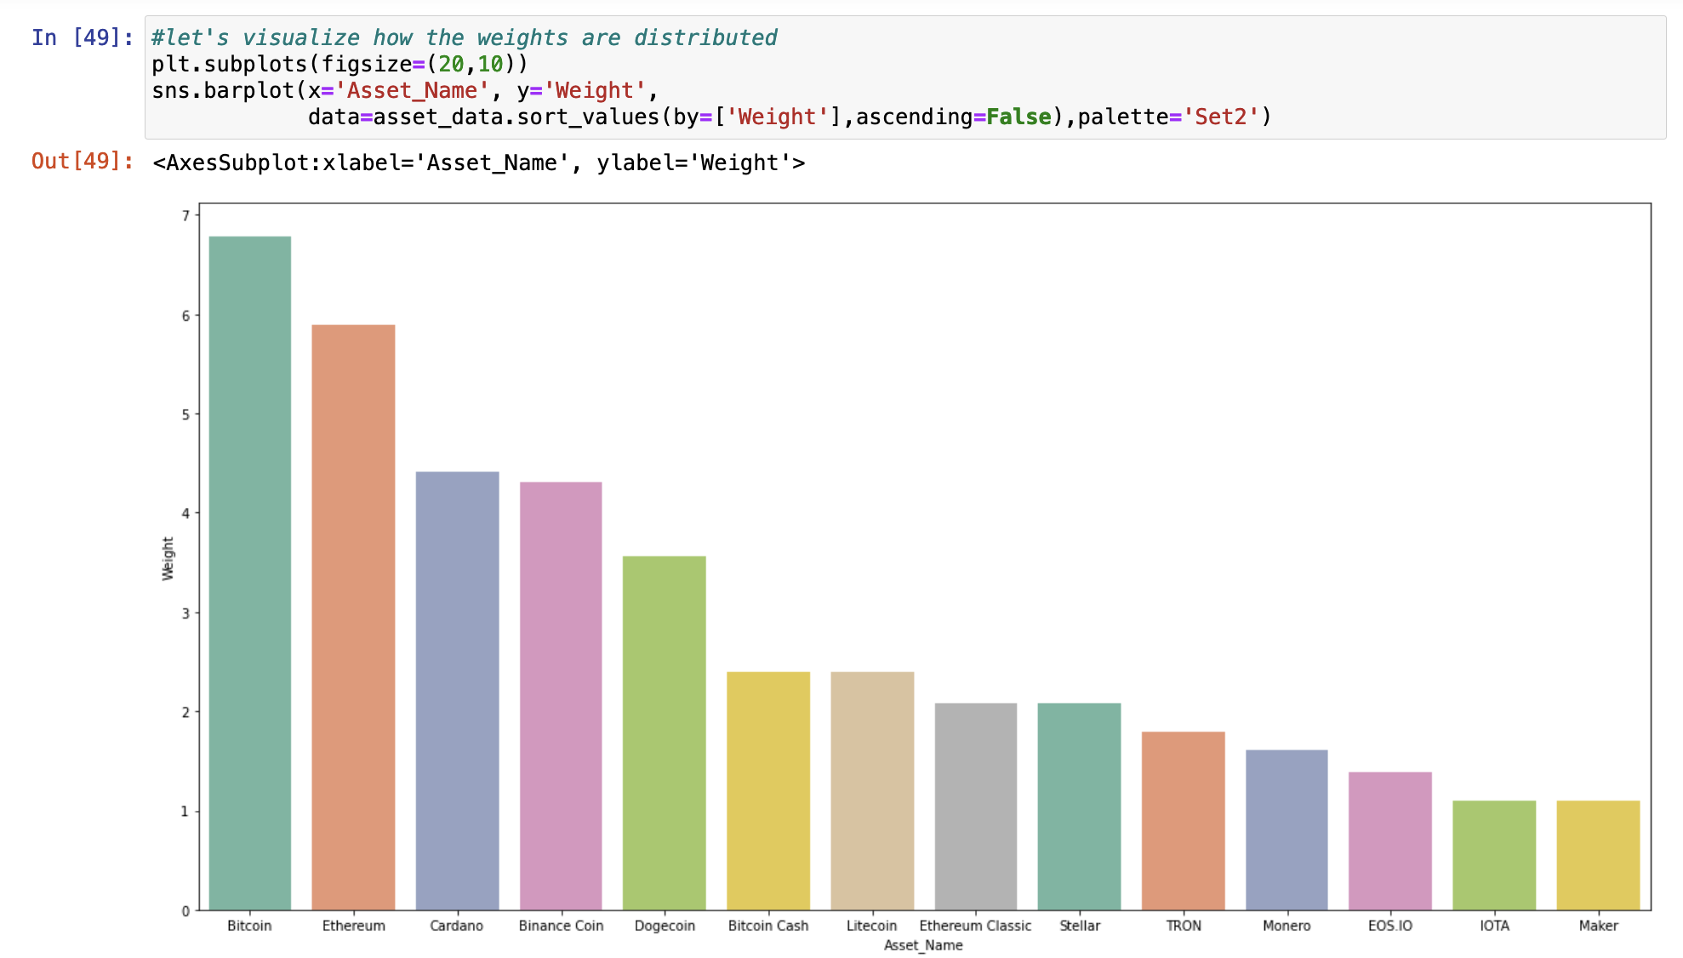

Slide 11
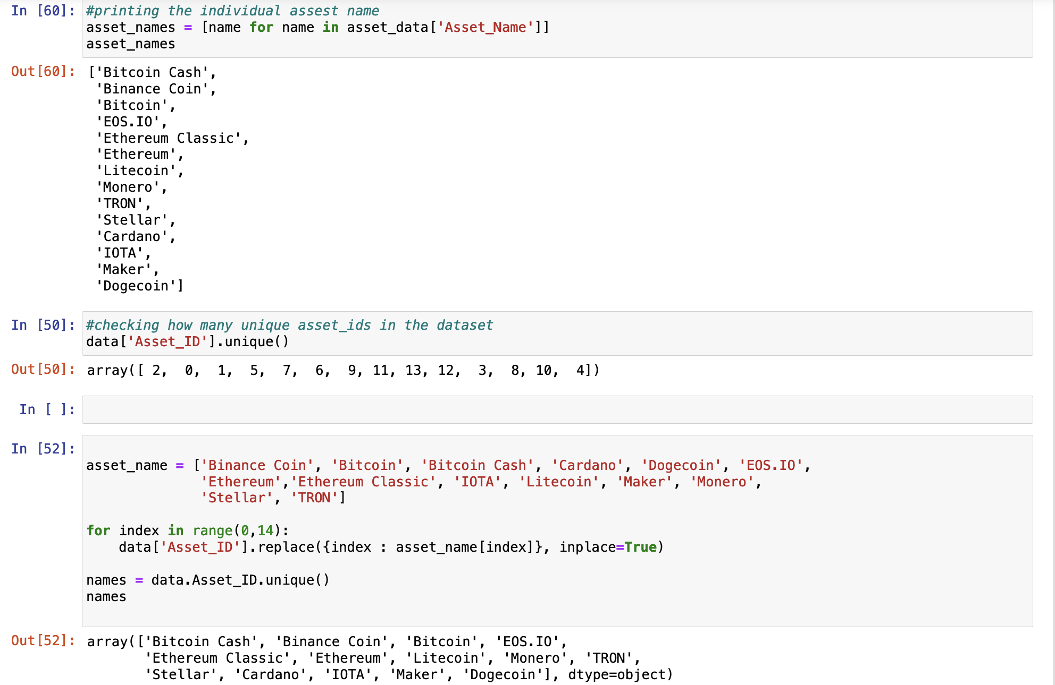

Slide 12
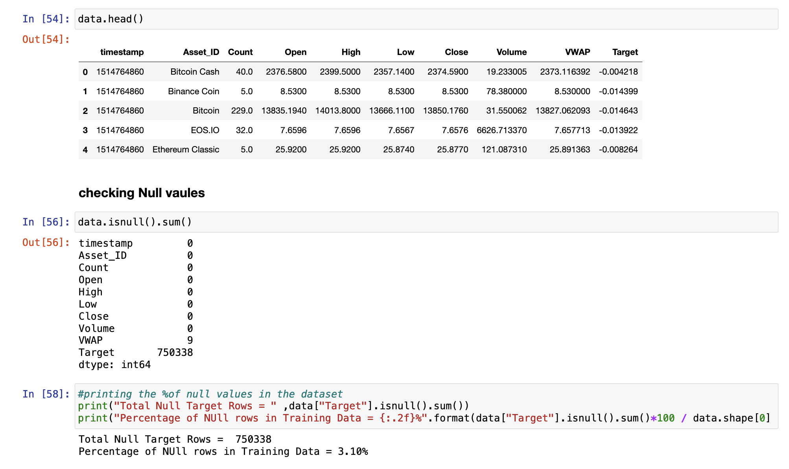

Slide 13
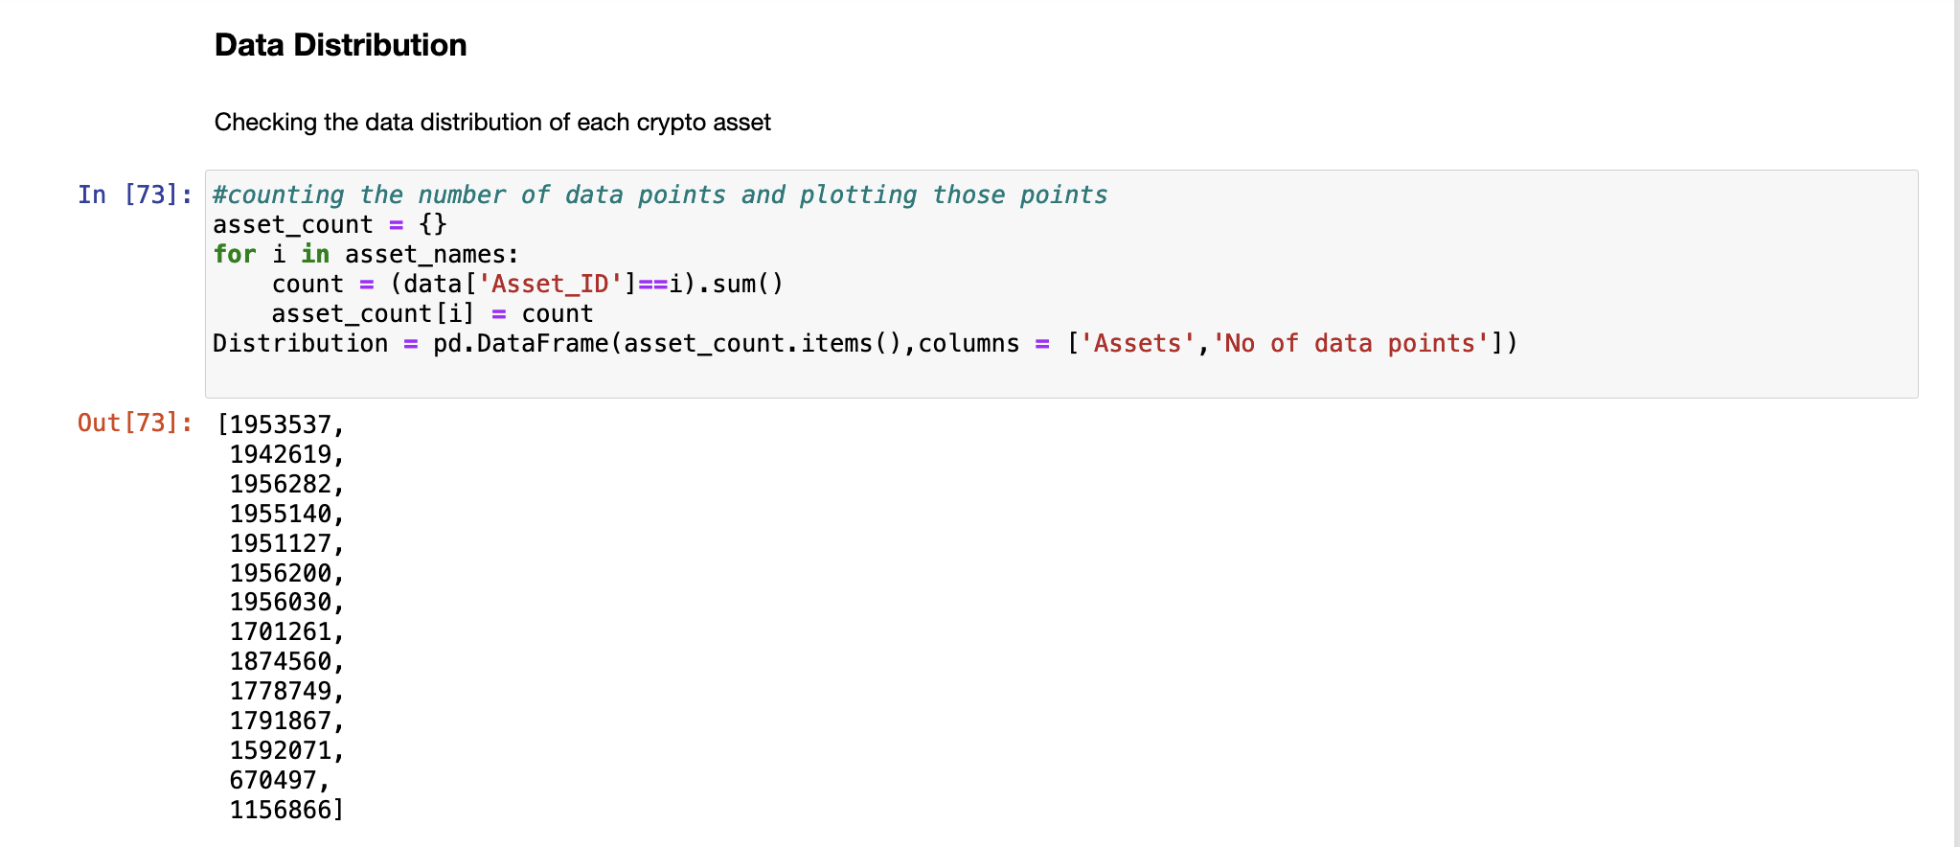
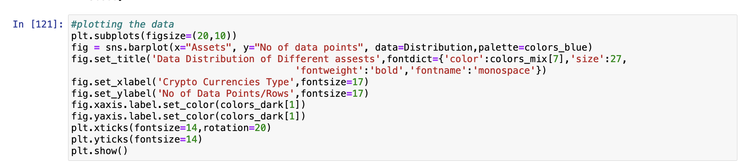

Slide 14
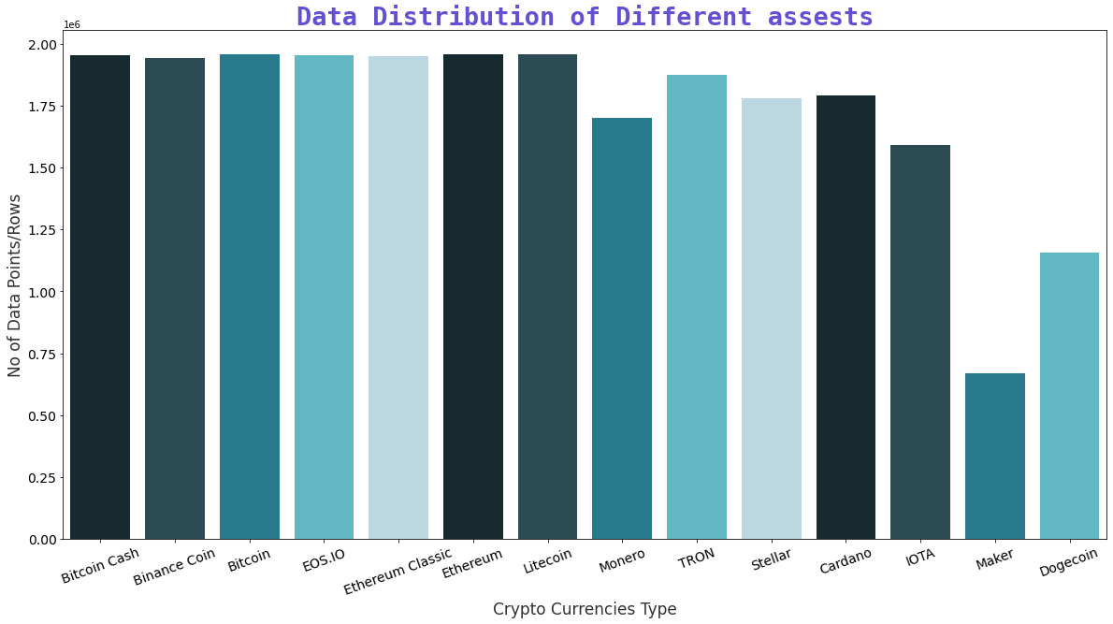

Slide 15
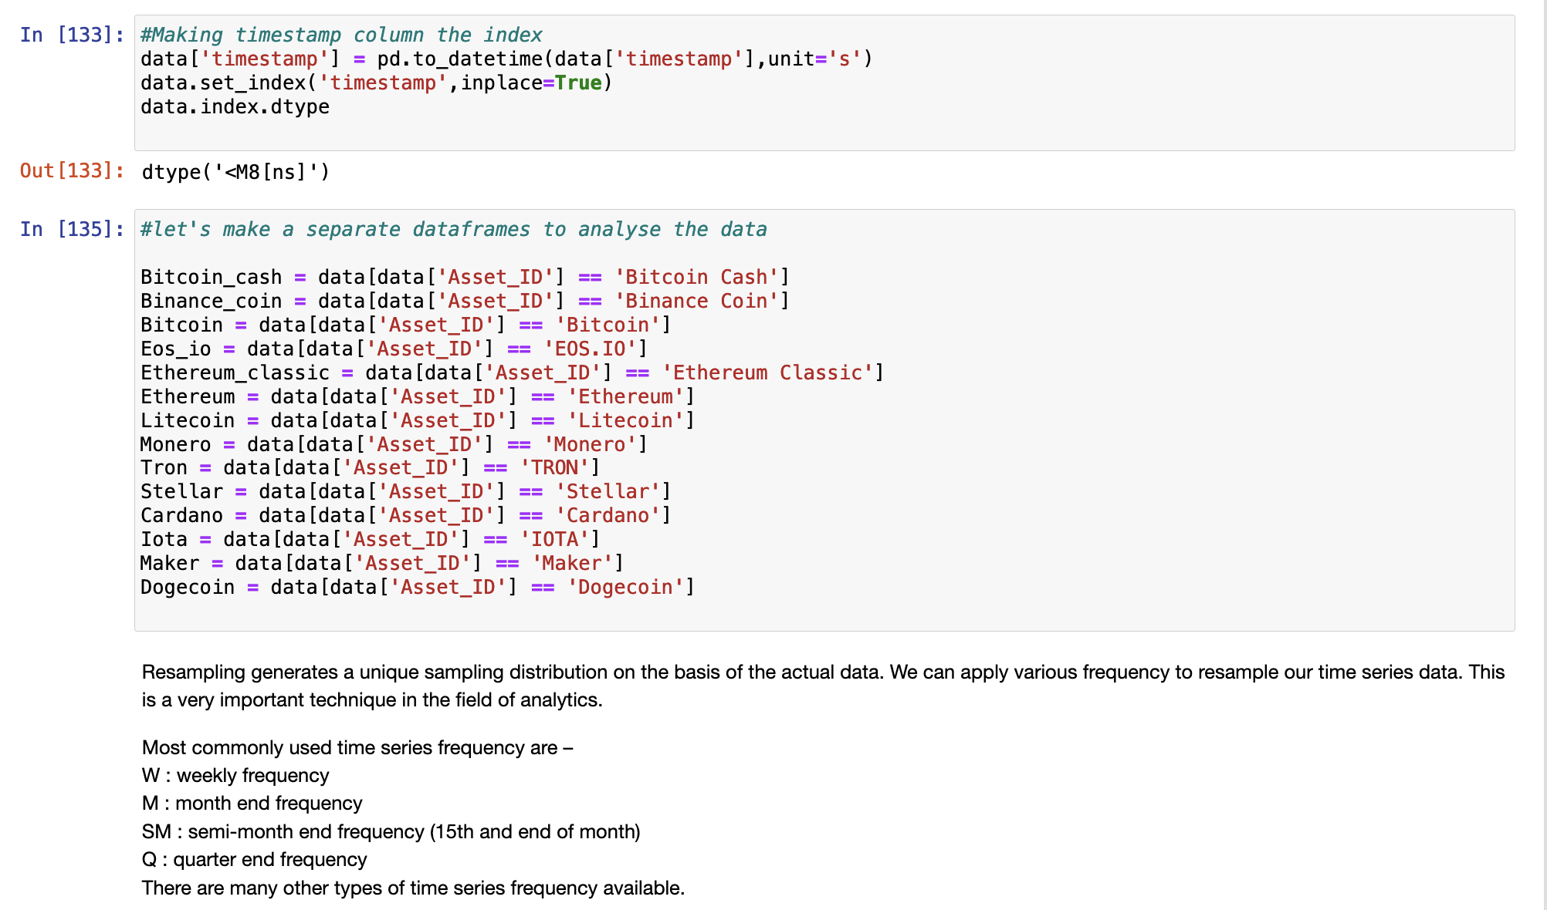

Slide 16
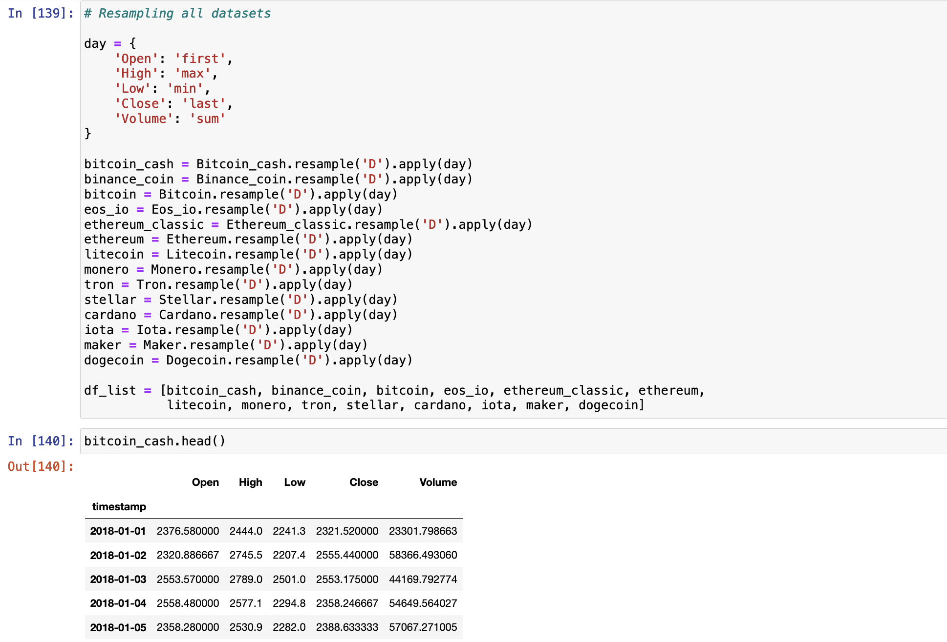

Slide 17
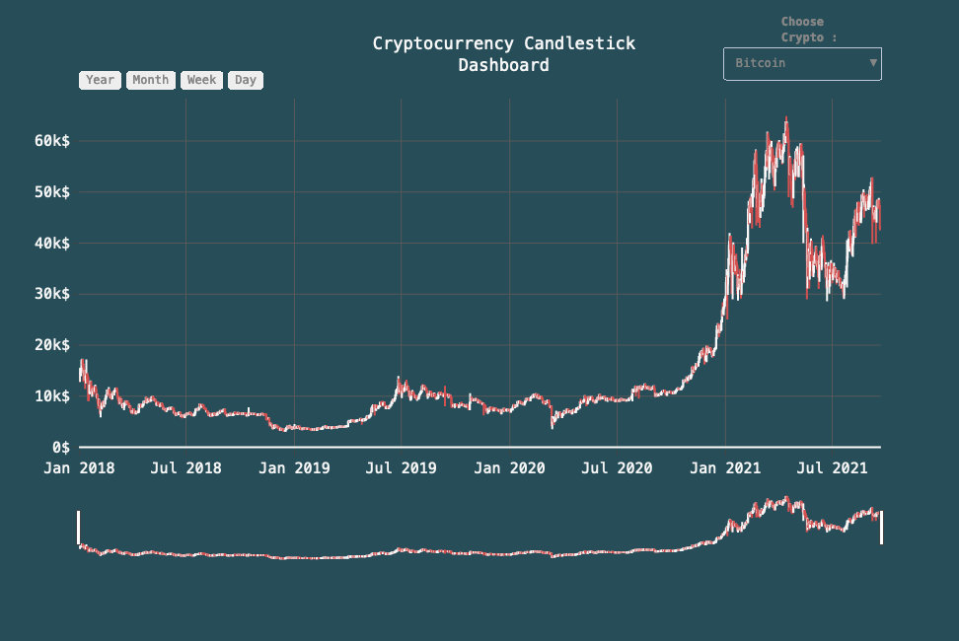

Slide 18
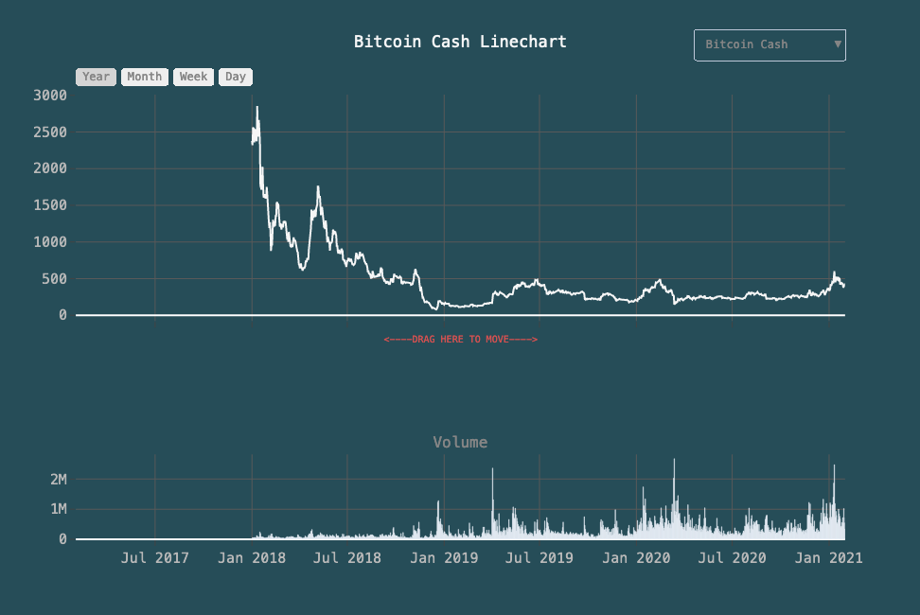

Slide 19
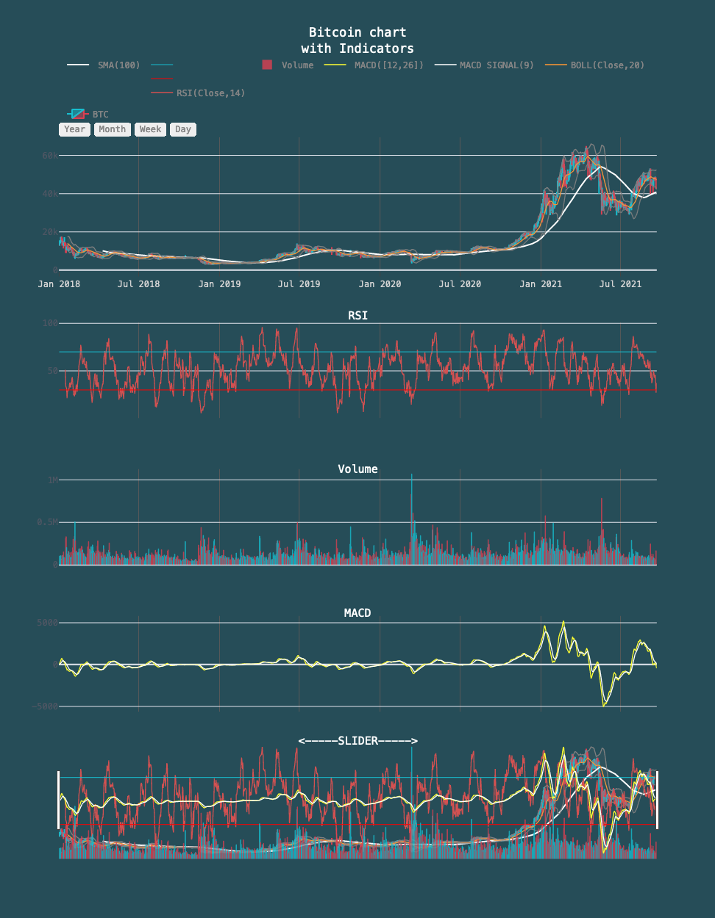

Slide 20
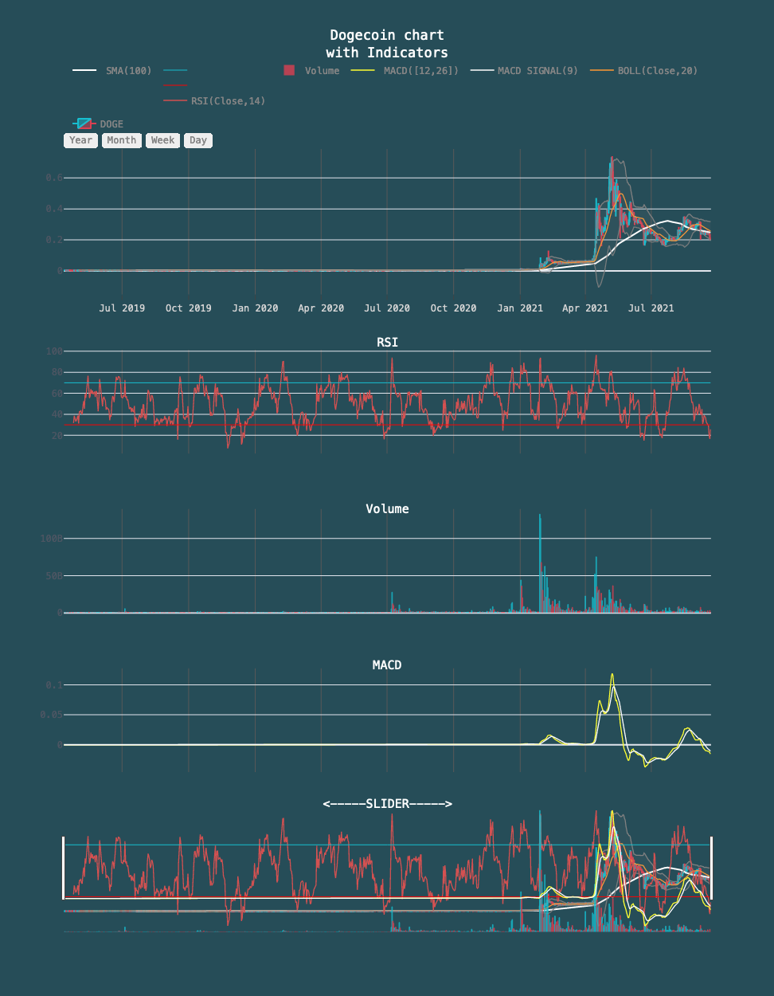

Slide 21
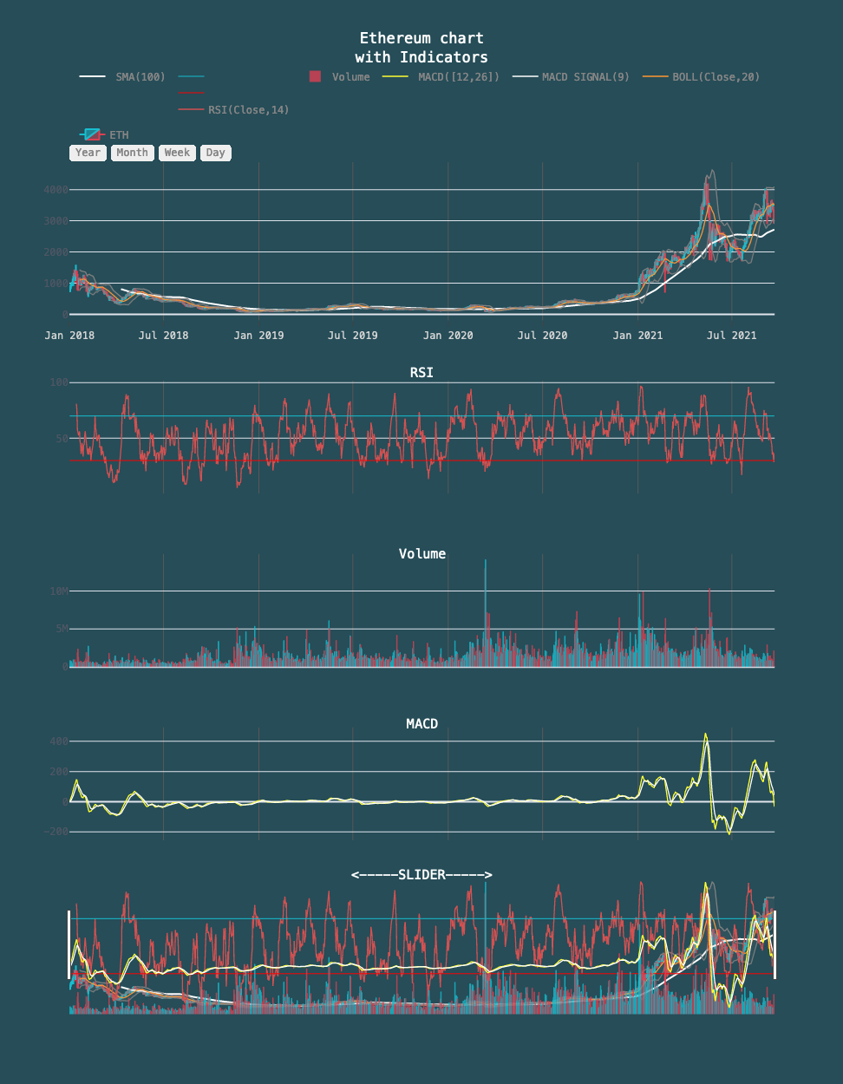

Slide 22
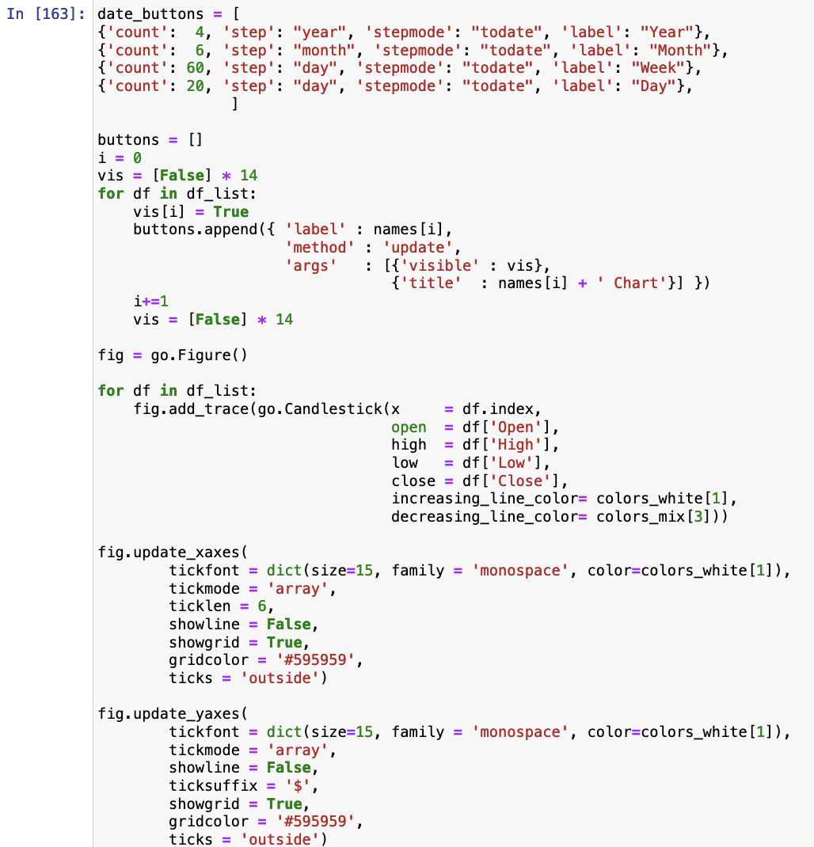
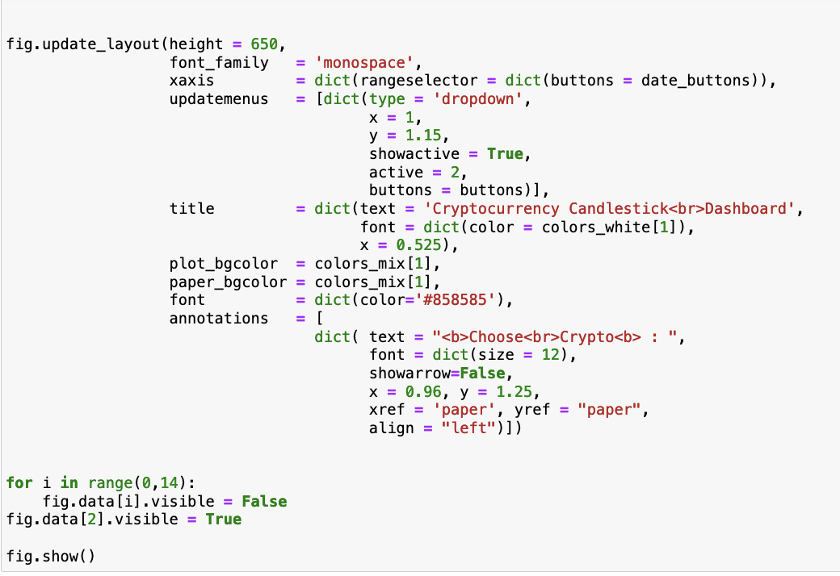

Slide 23
To be Continued…………………..

